Slide 1
Geography Awards Ceremony
2021

Slide 2
All prize winners receive $100 and a Dartmouth backpack.

Slide 3
George Perkins Marsh
was a member of the U.S. Congress, an author and farmer, and was the U.S. Minister to Turkey and Italy. He was also a philologist of international reputation and, importantly for us, he graduated from Dartmouth in 1820 with highest honors. He briefly was a resident of Woodstock, VT and is the author of the book The Earth as Modified by Human Activity, possibly the earliest Anglophone treatise on human-environment geography. This work eventually helped found the environmental movement in the United States and to place Geography in the forefront of environmental concerns about human impacts on the planet.

Slide 4
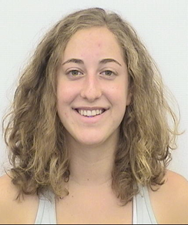
Awardee
“It’s a sign of the times that Sophie Basescu and I have met every week for the last year, but we have yet to meet in person. I was assigned as her thesis adviser and Sophie was a delight to work with. Her creativity and drive lifted her over IRB hurdles and through her interviews and data collection. She produced a terrific thesis under the most difficult of circumstances.”
Sophie Basescu
George Perkins Marsh

Slide 5
Alexander von Humboldt
was a member of the U.S. Congress, an author and farmer, and was the U.S. Minister to Turkey and Italy. He was also a philologist of international reputation and, importantly for us, he graduated from Dartmouth in 1820 with highest honors. He briefly was a resident of Woodstock, VT and is the author of the book The Earth as Modified by Human Activity, possibly the earliest Anglophone treatise on human-environment geography. This work eventually helped found the environmental movement in the United States and to place Geography in the forefront of environmental concerns about human impacts on the planet.

Slide 6
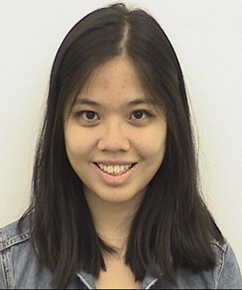
Awardee
“Grace Chahyadinata made a strong impression on her professors in the department, with one describing her as “one of the most intellectually curious, motivated, and self-disciplined students” with whom they have ever worked. Another called her “incredibly motivated” and someone who always works to “attain a deep knowledge of the course material.” She enhanced everyone’s learning experience with her insightful comments and nuanced perspectives.
This past year, Grace completed an independent study project, titled ‘The Politics of Insanity: Understanding the Significance of Place in Indonesia’s Mental Healthcare.’ The research examines how historical economic disparities, social determinants, and political capacities affect the quantity and quality of psychiatric treatments in Indonesia’s provinces. Despite very challenging circumstances, Grace conducted an impressive number of interviews with key actors in Indonesia’s mental health care sector to produce an excellent research paper.
Grace, it was a pleasure for all of us in the Geography Department to learn with and from you. We wish you the best in your future endeavors.”
Grace Chahyadinata
Alexander von Humboldt

Slide 7
Thelma Glass
was a professor of geography at Alabama State University where she taught for over 40 years. She was also deeply committed to social change, having been a member of the Women’s Political Council, which helped organize the Montgomery Bus Boycott in 1955-56, a key moment in the civil rights movement. In addition to her academic interests in economic, cultural and physical geography, she was known around the Alabama State campus as a teacher-activist willing to put her ideals into concrete actions. Accordingly, we grant this prize to a graduating senior who best reflects Professor Glass’ spirit as a scholar-activist.

Slide 8
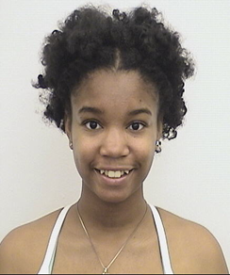
Awardee
“Jasmine Butler is not only an incredible scholar (and MMUF Fellow and Udall Scholar), she is also an impassioned mentor to her junior colleagues through student organizations such as Black Girls are Magic and Black Praxis as well as in her everyday life and work. She brought the same energy toward making Dartmouth College a more socially just campus through her work with the Consortium of Studies on Race, Migration and Sexuality and with Dartmouth’s Office of Pluralism and Leadership as an OPAL.
Jasmine is taking her passion for environmental justice her new job with Power Shift Network which supports youth-focused climate justice organizations”
Jasmine Butler
Thelma Glass

Slide 9
Doreen Massey
was a geographer of incredible breadth, with pioneering works in economic, feminist, Marxist and cultural geography. But she was centrally concerned with power relationships in all their complexity and how to challenge them when necessary. This is reflected in a quote: “A lot of what I’ve been trying to do…is to bring space alive, …to make it relevant, to emphasize how important space is in the lives in which we live…(s)pace is not a flat surface…it’s like a pincushion of a million stories.” She was also fiercely committee to creating societies where there is democracy, equality and freedom, and to the creative and radical movements that might bring about such change. Accordingly, this Award goes to the student who exemplifies Massey’s brilliant interdisciplinarity and socially relevant scholarship.

Slide 10
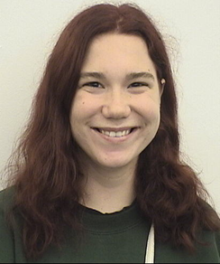
Awardee
“Caroline Atwood has succeeded in producing a senior thesis that, taking inspiration from the work of Doreen Massey, sheds light on the placemaking processes of theme parks. By highlighting how theme parks reflect the power hierarchies in society and how people’s experiences can transform these hierarchies, Caroline’s research has also exemplified Massey’s insights on the open-ended and creativity that can define place at its best.”
Caroline Atwood
Doreen Massey

Slide 11
Rachel Carson
Silent Spring, published in 1962, ushered in the modern environmental movement in the United States and influenced a generation of conservationists, scientists, and grassroots activists concerned over the negative impacts of economic activities on ecological systems and human health. A long-time employee of what became the US Fish and Wildlife Service, she was a prolific writer whose work appeared in numerous journal, newspapers, and magazines throughout the 1940s, 50s and 60s. She was a vocal and articulate defender of her belief that unchecked industrial activities were bringing about catastrophic change to the natural world in the United States and elsewhere. This Award is given to the student who best represents Rachel Carson’s passion for the outdoors, intelligence, and commitment to political change.

Slide 12
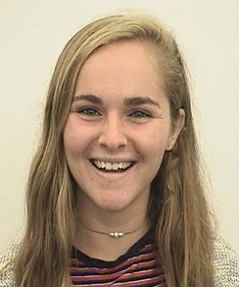
Awardee
“When Rachel Kent wasn’t writing her brilliant thesis about more-than-human entanglements and care on small-scale farms, you could find her at Dartmouth’s Organic Farm, sometimes at a vineyard, working in the sustainability office, in the woods, or organizing with her colleagues of the Dartmouth Student Union—she lives eats and breathes life through her concern for the environment and for her fellow students.
This fall, Rachel will be attending the Master of Gastronomy: World Food Cultures and Mobility at the University of Gastronomic Sciences Pollenzo, Italy on a Fulbright Scholarship.”
Rachel Kent

Slide 13
The National Council for Geographic Education
is a 3500 member organization whose objective is to foster and increase the effectiveness of geographic education in North America. Each year the Council presents an Excellence in Scholarship Award to an outstanding senior geography major at each of several American colleges and universities. Our NCGE award goes to the Major with the highest departmental GPA.
This year’s winner is Rachel Kent with an overall GPA of 3.99 and an outstanding geography GPA of 4.0. Congrats Rachel.
Rachel Kent

Slide 14
Robert Huke
graduated from Dartmouth in 1948, went on to earn his PhD at Syracuse, and returned to Dartmouth to teach and research in 1953. He served in the department for 43 years. He focused on food and population in his teaching and research and spent many winter terms at IRRI—the International Rice Research Institute in Los Banos, Philippines—mapping and deepening his understanding of the cultures of rice farming. He won several teaching awards and was loved by many students. But above all else, Bob is remembered in our department for his enthusiasm for Geography.
Accordingly, the Geography faculty use this award to recognize the student best embodies Bob Huke’s spirit and passion for Geography.

Slide 15
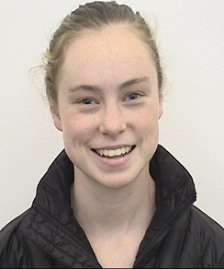
Awardee
Emilie Baxter
Robert Huke
“Emilie Baxter exemplifies the best of geography, bringing together human geography and GIS with admirable skill in her thinking and her course work. In addition, in classes and out, we have admired the care Emilie has taken with the geographic research she has been a part of, with us, and with her classmates. We wish her the best in what we know will be a bright future.”

Slide 16
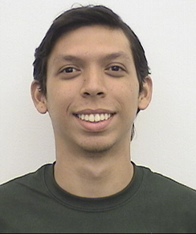
Awardee
Ruan Rodrigues
Robert Huke
“From first-year fall through senior spring, Ruan Rodrigues was such a regular and welcome presence in our classes that it would be sad to see him go. Fortunately, we don’t have to, as we have convinced him to stay on another year as our post-baccalaureate teaching fellow. Congratulations Ruan!”

Slide 17
The Geography Stretch ’76
Fund is a true endowment established to help support the study of Geography at Dartmouth College. The investment is intended to ensure that they College continues at the forefront of American higher education and that its students are prepared for the challenges and opportunities they will meet as they assume positions of Leadership. This award is given to the student who best exemplifies the Stretch and its focus on original field work.

Slide 18
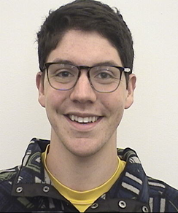
Awardee
Oliver Chartok
Geography Stretch ‘76
“for his enthusiasm and creativity, as well as his commitment and respect for all fields of geography as a means to understand people and their place in a changing world.”

Slide 19
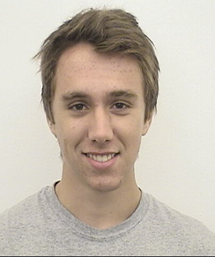
Awardee
Noel Siegert
Geography Stretch ‘76
“for his thoughtful engagement with each inquiry he undertakes, his classroom leadership, and his critical, independent thinking.”

Slide 20
Guido R. Rahr ‘51
came from a family of conservationist-philanthropists. the 1980’s, the Rahr Foundation—in honor of Guido’s love of geography—donated a tract of land in Oregon to the College with the intent of supporting the Geography Department. The land was eventually sold and the endowment has grown to the point where it now supports a range of activities in the department, including most obviously the Rahr GIS lab. This Award goes to the Major who best represents Guido’s passion for cartography and spatial science.

Slide 21
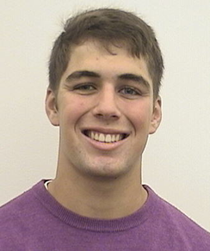
Awardee
Jared O. Cape
Guido R. Rahr ‘51
“This award goes to Jared Cape, for his senior thesis on New Hampshire electoral geographies and for his keen interest in public policy, which he has pursued at the state, national, and international level. Guido Rahr would have appreciated Jared's geographically informed agenda to make the world a better place through public policy, and we wish him the best in his future endeavors.”

Slide 22
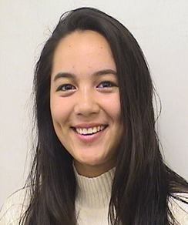
Awardee
Emily Luy-Tan
Guido R. Rahr ‘51
“We have a tradition that this Rahr award is given to the student who has spent most hours in the Rahr computer lab, which indicates that she really loves GIS. As a GIS professor, I would say that Emily Luy-Tan definitely deserves this award, even though she didn’t have chance to spend hours in Rahr lab in this past year due to the pandemic. Emily does have a passion about GIS. For that I only want to quote myself: In the final of my class, Emily was the only one who got a score above 95 and actually she got 99. I told her, “I could have given you 100, but my professor told me when I was a student: No one should get 100 in the exam of a GIS class! So, I managed to deduct one point from your exam.” That is how good she is. Congratulations, Emily.”

Slide 23
Leah Horowitz ‘02 Award for Social Justice
This award goes to the student whose time at Dartmouth epitomizes President Dickey's charge that "the world's problems are your problems.'" It honors Leah Horowitz, a Geography major who in 2009 died tragically in Ghana, where she worked for a development agency. As a student Leah taught and humbled us; she combined great intellect with wanting to to know how what she learned here was going make a difference in the larger world. She lost no time in doing that, first as an AmeriCorps volunteer and then working for the International Food Policy Research Institute where, notably, she asked to be transferred from DC to the field office in Ghana. It is to honor Leah’s memory—and her deep commitment to social justice—that we give this award. The recipient receives a compass, and the department donates $100 to Action Against Hunger, an organization chosen by Leah's family.

Slide 24
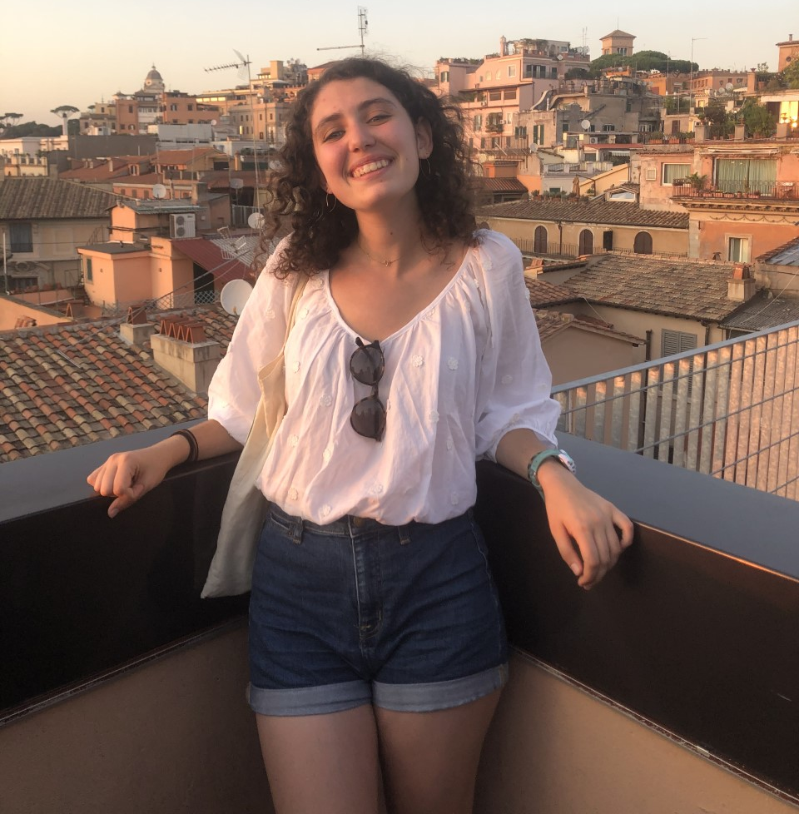
Awardee
“We cannot think of a more deserving student for this year’s Leah Horowitz Award then Rachel Florman. Not only did she complete a Senior Honors Thesis examining how government policies intervene into people daily lives with profound impacts on reproductive bodies, she has a history of advocacy and activism promoting reproductive justice in New Hampshire and the United States. Over her four years at Dartmouth she has also been a tireless advocate for student well-being through the Student Assembly. Congratulations, Rachel!”
Rachel Florman
Leah Horowitz ‘02 Award for Social Justice

Slide 25
Congrats to all of our award winners! We will miss you!

